Slide 1


VOLUNTEER ORIENTATION
2022-2023
MANATEE BAY ELEMENTARY

Slide 2

AGENDA
Why you are important to us
Safety Updates
Guidelines for Volunteers
MBE Expectations
Visit the Volunteer Website

Slide 3
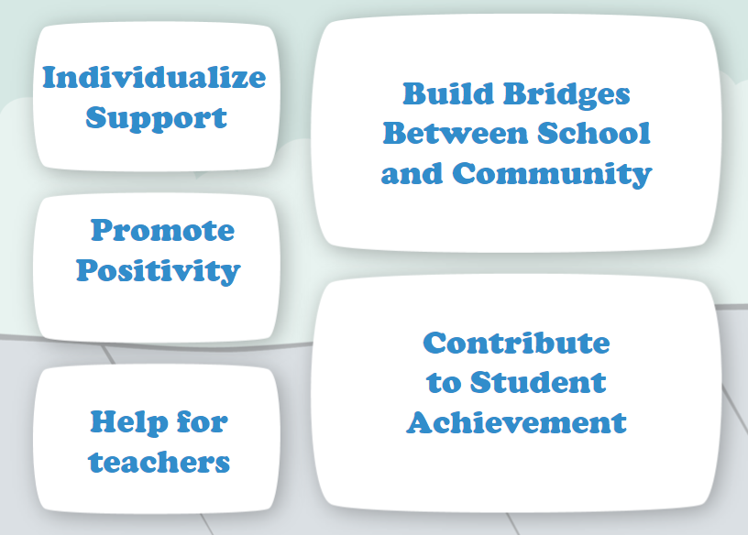
WHY VOLUNTEERS ARE IMPORTANT?

Slide 4
GUIDELINES FOR VOLUNTEERS
1. The safety and education of students must be the main concern while engaged in school activities.
2. Volunteers may not give students medication.
3. Classroom supervision and student discipline are the responsibilities of the teacher and school.
4. Volunteers will be assigned only to staff members requesting assistance.

Slide 5
GUIDELINES FOR VOLUNTEERS (cont’d)
5. Volunteers should set a good example for students by their manner, appearance and behavior.
6. Volunteers are required to complete an application and must be approved before volunteering.
7. Volunteers are required to sign in and sign out at the office and record off campus service hours.
8. Volunteers are required to report to the office to receive a badge each time they come to volunteer.
9. Volunteers cannot be alone with students at any time.

Slide 6
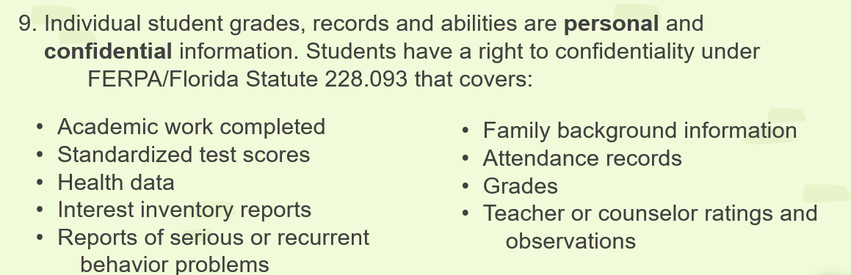
FINAL GUIDELINE FOR VOLUNTEERS

Slide 7

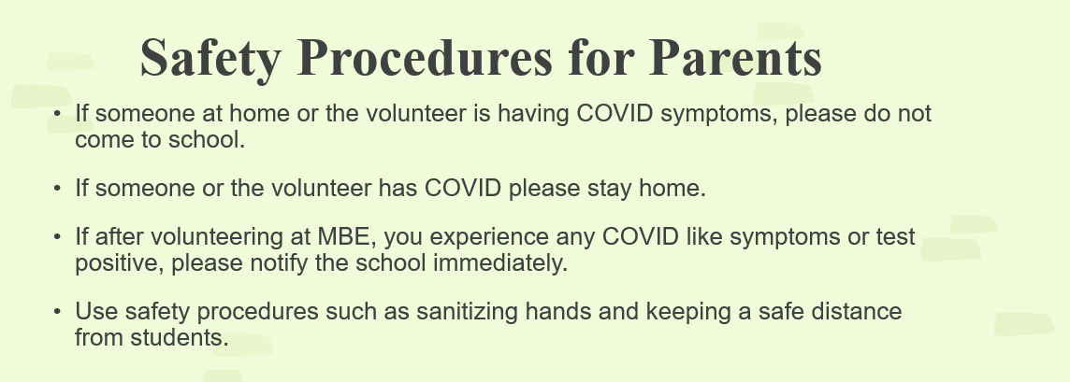
SAFETY PROCEDURES FOR PARENTS

Slide 8
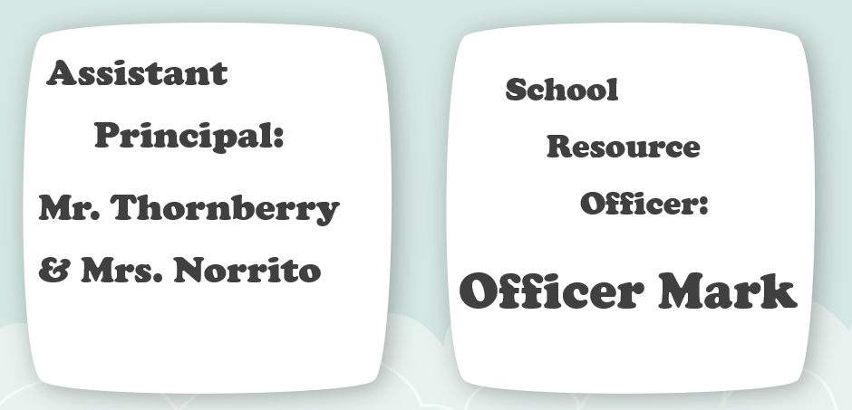
SAFETY UPDATES
Officer Mark:
Monitors campus to ensure all doors are locked.
Monitors hallways to ensure classroom doors are closed and locked.
Is visible during arrival and dismissal.

Slide 9
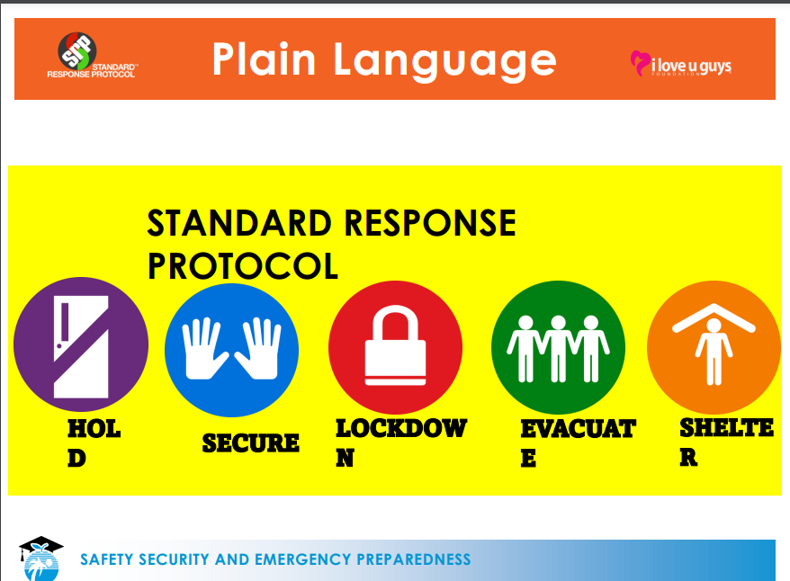

Slide 10
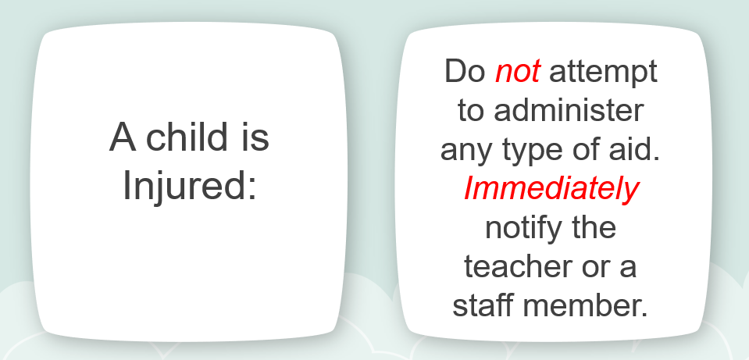
WHAT TO DO IF …..

Slide 11
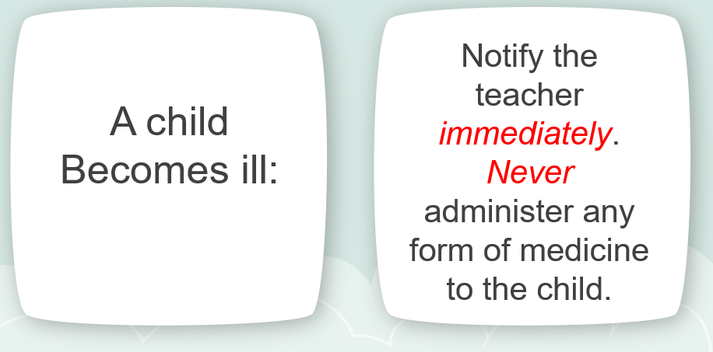
WHAT TO DO IF …..

Slide 12
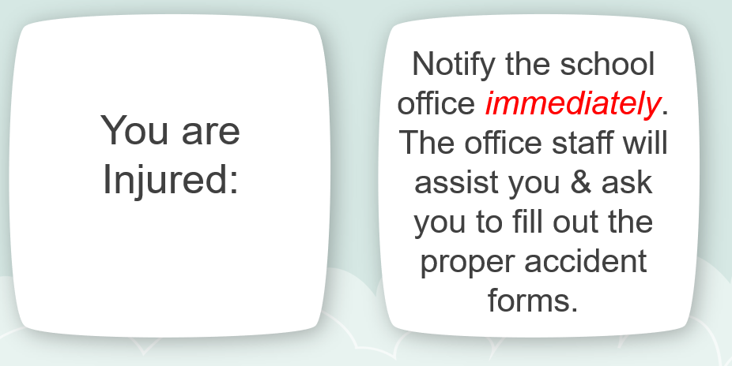
WHAT TO DO IF …..

Slide 13
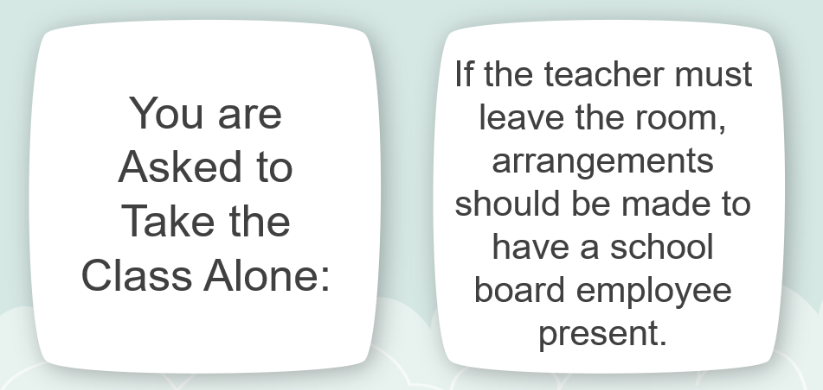
WHAT TO DO IF …..

Slide 14
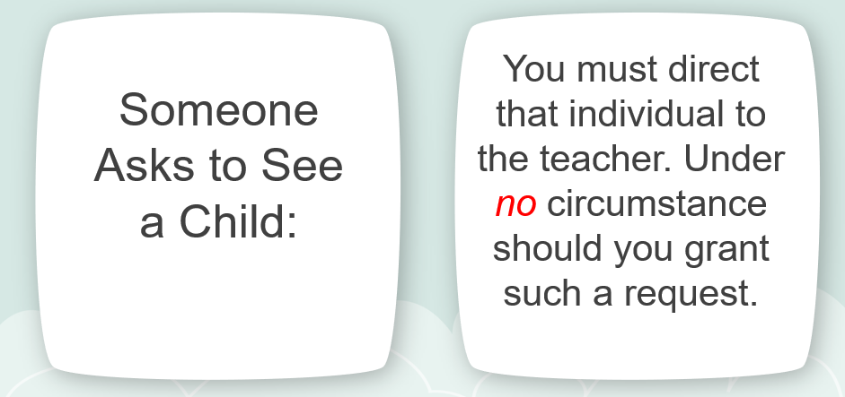
WHAT TO DO IF …..

Slide 15
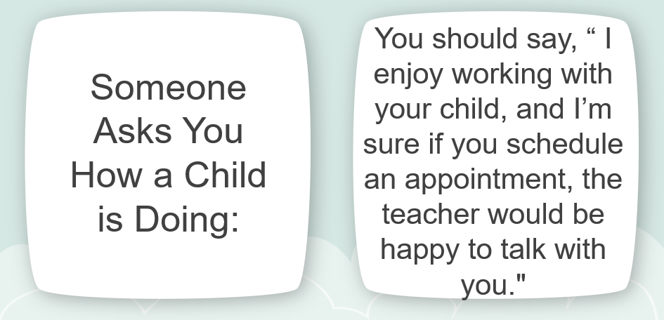
WHAT TO DO IF …..

Slide 16
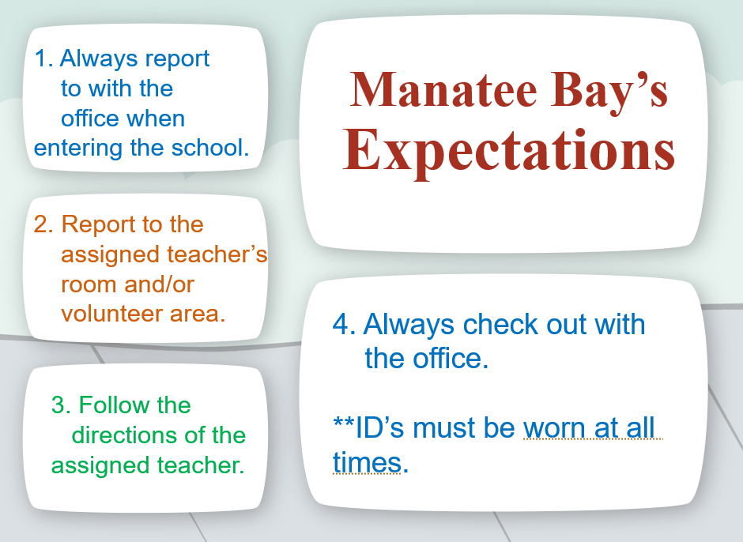

Slide 17
A SPECIAL WORD TO PARENTS
You are important to our school.
Essential to hold confidentiality
Be cautious of what is said in front of your own child.
Refrain from discussing capabilities, behavior, attitudes of students with anyone besides school personnel.

Slide 18

IMPORTANT

Slide 19
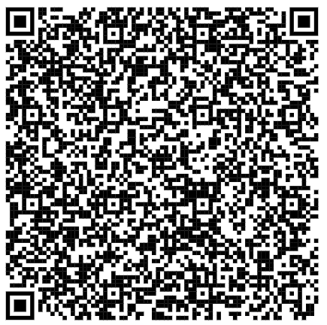
IMPORTANT
Scan the QR code and complete the form to record your attendance.

Slide 20
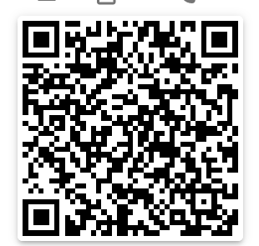
IMPORTANT
Scan the QR to view the
Pathways for Volunteer Manual
https://browardschools.instructure.com/courses/1430443/pages/parent-anti-bullying-training

Slide 21

THANK YOU
Holly Casios (Literacy Coach, Volunteer Coordinator holly.casios@browardschools.com
@ManateeBayElem
MANATEE BAY ELEMENTARY

